Slide 1
Learning & Development Enabling development, Impacting growth…
BIG-04
Hadoop Eco-Systems – Sqoop, Flume and Oozie – Module 05

Slide 2
Module Outline
Sqoop
What is Sqoop
How does it work
Basic Syntax
Using Import /Export Tool
Architecture
Flume
Introduction and its System Requirements
An Architecture of Flume
A single-node Flume configuration

Slide 3
Module Outline
Oozie
Motivation for Oozie
Oozie Overview
Defining an Oozie workflow with Sample design
Workflow Job – Sample Code

Slide 4
Hadoop Eco-System - SQOOP

Slide 5
Sqoop
A Command line interface
Import data from RDBMS to HDFS
Export data from HDFS to RDBMS
Uses Map Jobs from Map Reduce
Supports incremental loads
Licensed by Apache
Uses Plug-in for new types of data source

Slide 6
How does it work?
Data Sliced into partitions
Mappers transfer data in parallel
Data types determined via meta data
Many data transfer formats supported
CSV, Avro
Can import into
Hive (Use -hive-import flag)
Hbase (use -hbase flags)

Slide 7
Sqoop: Basic Syntax
Standard syntax:
Tools include:
Options include:
$sqoop tool-name [tool-options]
import
import-all-tables
list-tables
export
--connect
--username
--password

Slide 8
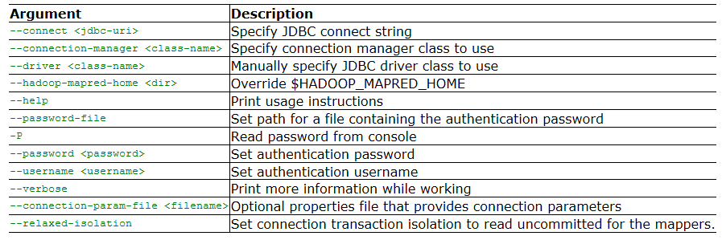
Using import Tool
Import tool imports RDBMS table data to HDFS
Standard import syntax
Generic Arguments
$ sqoop-import (generic-args) (import-args)

Slide 9
Using import Tool(continued)
Importing data from mysql to hdfs
sqoop import \
--connect jdbc:mysql://mysql.example.com/dbname \
--username sqoop \
--password sqoop \
--table cities \
--target-dir /etl/input/cities \
-m 5
Parameters explained in next slide.

Slide 10
Using import Tool(continued)
Parameters in depth
--connect : expects connection string of the database
--username: expects username of database
--password: expects password of database
There are different arguments to protect password
-P : Accepts password on command line without displaying
--password-file: Password is saved in a file and that file path is passed in sqoop coomand
--table: expects name of source rdbms table
--target-dir: expects path of target hdfs directory
-m : expects number of mappers to run(for defining explicitely)
Sqoop run 4 mappers by default even if not mentioned using –m argument

Slide 11
Using import Tool(continued)
Selecting the Data to Import:
--where: argument can be used within sqoop command to select the data with some condition
Eg:
sqoop import --connect jdbc:mysql://mysql.example.com/dbname \
--username sqoop --password sqoop --table cities --target-dir /etl/input/cities \
--where “id > 400” -m 2
Free-form Query Imports:
--query: argument is used within sqoop command to specify queries
Eg:
sqoop import --connect jdbc:mysql://mysql.example.com/dbname \
--username sqoop --password sqoop --table cities --target-dir /etl/input/cities \
-- query 'SELECT a.*, b.* FROM a JOIN b on (a.id == b.id)‘ -m 2

Slide 12
Using import (continued)
--split-by
is used for slicing data to multiple parallel tasks.
Usually done on primary key of table.
Syntax:
$ sqoop-import --connect <jdbc:mysql://192.168.1.121/dbname> \
--username root --password root \
--table <tabl name> \
--split-by <column name> \
--target-dir <HDFS path>

Slide 13
Using import (continued)
Import data to HDFS as avro data file or sequence file
Syntax:
$ sqoop-import --connect jdbc:mysql://192.168.1.121/test \
--username root --password root \
--table <table name> \
--target-dir <HDFS Path>
--as-avrodatafile
Note: --as-sequencefile can be used in place of –as-avrodata file for sequence file

Slide 14
Using import Tool- Example
Import a table called employees from a database called personnel in a MySQL RDBMS
Imports only records with id greater than 1000
Import all the tables from RDBMS to HDFS
→“sqoop import” can also be used in place of “sqoop-import”
$ Sqoop-import --connect jdbc:mysql://database.example.com/personnel
--username hadoop --password hadoop --table employees –m 4
$ Sqoop-import --connect jdbc:mysql://database.example.com/personnel
--username hadoop --password hadoop --table employees where “id > 1000” –m 4
$ Sqoop-import –all-tables --connect jdbc:mysql://database.example.com/personnel
--username hadoop --password hadoop –m 5

Slide 15
Using import Tool-Incremental Imports
Sqoop provides an incremental import mode which can be used to retrieve only rows newer than some previously-imported set of rows.
Incremental import arguments:
Sqoop supports two types of incremental imports: append and lastmodified.
You can use the --incremental argument to specify the type of incremental import to perform.
specify append mode when importing a table where new rows are continually being added with increasing row id values
You specify the column containing the row’s id with --check-column. Sqoop imports rows where the check column has a value greater than the one specified with --last-value.

Slide 16
Using import Tool-Incremental Imports(continued)
An alternate table update strategy supported by Sqoop is called lastmodified mode.
Use this when rows of the source table may be updated, and each such update will set the value of a last-modified column to the current timestamp.
Rows where the check column holds a timestamp more recent than the timestamp specified with --last-value are imported.

Slide 17
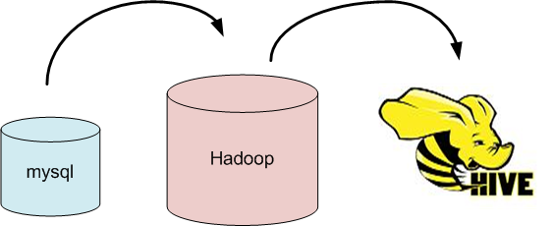
Sqoop: Importing To Hive Tables
The Sqoop option --hive-import will automatically create a hive table from the imported data
Imports the data
Generates the Hive CREATE TABLE statement
Runs the statement
Note: This will move the imported table into Hive’s warehouse directory

Slide 18
Importing data to Hive Table
Load data from MySql into Hive
$sqoop-import --connect jdbc:mysql://<mysql host>:msql port?/db3 \
--user name <hadoop> \
--password <hadoop> \
--table <table name> --hive-table <Hive tableName> \
--create-hive-table \
--hive-import --hive-home <hive path>

Slide 19
Importing data to HBase
Load data from MySql into HBase
$sqoop-import --connect jdbc:mysql://<mysql host>:msql port?/db3 \
--user name <hadoop> \
--password <hadoop> \
--table <table name> \
--hbase-table <table name>\
--column-family <column family name>
Note: HBase table and column family should exist prior using sqoop import commands

Slide 20
Sqoop: Other Options
Sqoop can take data from HDFS and insert it into an already existing table in an RDBMS with the command
For general Sqoop help:
For help on a particular command:
$sqoop-export [options]
$sqoop help
$sqoop help command

Slide 21
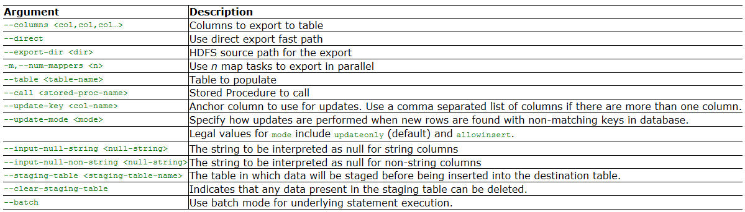
Using export Tool
Export tool exports HDFS data to RDBMS table
Standard import syntax
Export control arguments
$ sqoop-export (generic-args) (export-args)

Slide 22
Using export Tool(continued)
Exporting data from hdfs to mysql
$ sqoop-export
--connect jdbc:mysql://db.example.com/foo
--table bar \
--export-dir /results/bar_data
For more details on sqoop commands and arguments, refer :
http://sqoop.apache.org/docs/1.4.5/SqoopUserGuide.html

Slide 23
Architecture
Sqoop has moved from
- Sqoop1 to Sqoop2
Changed from client to server install
Now has web and command line access
Server now accesses Hive and Hbase
Oozie uses REST API

Slide 24
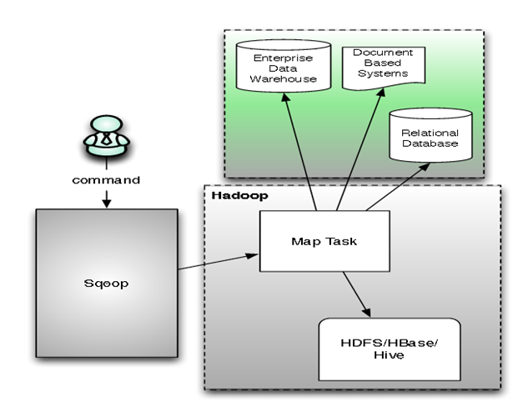
Sqoop 1 Architecture
Source : http://www.semtech-solutions.co.nz

Slide 25
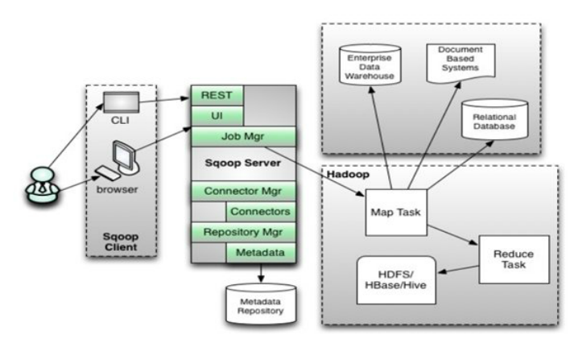
Sqoop 2 Architecture
Source : http://www.semtech-solutions.co.nz

Slide 26
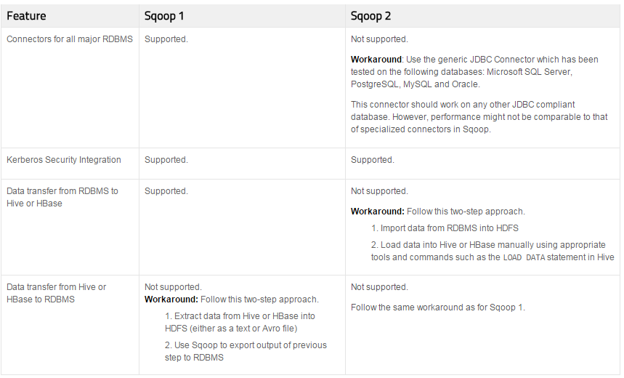
Features: Difference between Sqoop 1 and Sqoop 2

Slide 27
Quiz
1. Sqoop can be used to import data from flat file to HDFS?
True
False
2. How many default mappers sqoop run?
2
3
4
5

Slide 28
Quiz-Answers
1. Sqoop can be used to import data from flat file to HDFS?
True
False
2. How many default mappers sqoop run?
2
3
4
5
B: False
C: 4

Slide 29
Quiz
3. Which of the following sqoop command is used to load data from rdbms to hdfs?
export
import
Import-hive
None of the above
4. What value does --target-dir parameter expect when used with sqoop-import?
Path of local directory
Path of UNIX server
Path of HDFS directory
Both A & C
B: import
C: Path of HDFS
directory

Slide 30
Quiz-Answers
3. Which of the following sqoop command is used to load data from rdbms to hdfs?
export
import
Import-hive
None of the above
4. What value does --target-dir parameter expect when used with sqoop-import?
Path of local directory
Path of UNIX server
Path of HDFS directory
Both A & C
B: import
C: Path of HDFS
directory

Slide 31
Demo on Sqoop Commands

Slide 32
Demo on Sqoop Commands

Slide 33
Flume

Slide 34
Flume Overview
Apache Flume is a distributed, reliable, and available system for efficiently collecting, aggregating and moving large amounts of log data from many different sources to a centralized data store.
The use of Apache Flume is not only restricted to log data aggregation
Can be used to transport massive quantities of event data.
E.g.: Network traffic data, social-media-generated data, email messages and pretty much any data source possible.
Apache Flume is a top level project at the Apache Software Foundation.
Current stable version of Flume is 1.6.0
Flume is Open Source
Initially developed by Cloudera

Slide 35
System Requirements
Java Runtime Environment - Java 1.6 or later (Java 1.7 Recommended)
Memory - Sufficient memory for configurations used by sources, channels or sinks
Disk Space - Sufficient disk space for configurations used by channels or sinks
Directory Permissions - Read/Write permissions for directories used by agent

Slide 36
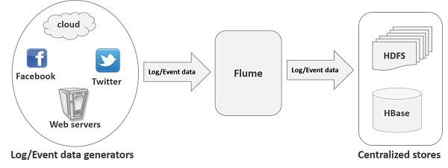
An Application of Flume

Slide 37
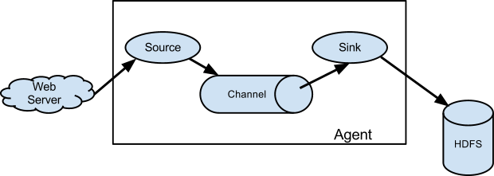
An Architecture of Flume
Source: http://flume.apache.org/FlumeUserGuide.html#data-flow-model

Slide 38
Flume Agent
Each Flume agent has :
Source
Tells the node where to receive data from
Sink
Tells the node where to send data to
Channel
A queue between the Source and Sink
Can be in memory only or ‘Durable’
Durable channels will not lose data if power is lost

Slide 39
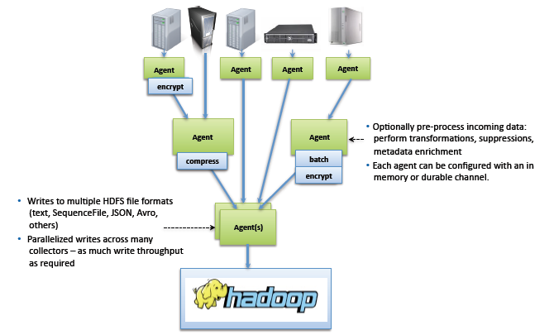
Flume Complex flows
Flume allows a user to build multi-hop flows where events travel through multiple agents before reaching the final destination.
It also allows fan-in and fan-out flows, contextual routing and backup routes (fail-over) for failed hops.

Slide 40
Types of Channels
Memory Channel
The events are stored in an in-memory queue with configurable max size.
It’s ideal for flows that need higher throughput and are prepared to lose the staged data in the event of a agent failures.
Data will be lost in case of power failure.
JDBC Channel
The events are stored in a persistent storage that’s backed by a database.
The JDBC channel currently supports embedded Derby.
This is a durable channel that’s ideal for flows where recoverability is important.
Kafka Channel
The events are stored in a Kafka cluster (must be installed separately).
Kafka provides high availability and replication, so in case an agent or a Kafka broker crashes, the events are immediately available to other sinks.
File Channel
By default the File Channel uses paths for checkpoint and data directories that are within the user home

Slide 41
Flume’s Design Goals: Reliability
The events are staged in a channel on each agent. The events are then delivered to the next agent or terminal repository (like HDFS) in the flow.
Data transfer between Agents and Channels is transactional
A failed data transfer to a downstream agent rolls back and retries
Can configure multiple Agents with the same task
e.g., two Agents doing the job of one “collector” – if one agent fails then upstream agents would fail over

Slide 42
Flume’s Design Goals: Scalability
Scalability
The ability to increase system performance linearly – or better – by adding more resources to the system
Flume scales horizontally
As load increases, more machines can be added to the configuration

Slide 43
Flume’s Design Goals: Manageability
Manageability
The ability to control data flows, monitor nodes, modify the settings, and control outputs of a large system
Configuration is loaded from a properties file
Properties file can be (re)loaded on the fly
File must be pushed out

Slide 44
Flume’s Design Goals: Extensibility
Extensibility
The ability to add new functionality to a system
Flume can be extended by adding Sources and Sinks to existing storage layers or data platforms
General Sources include data from files, Syslog, and standard output from a process
General Sinks include files on the local filesystem or HDFS
Developers can write their own Sources or Sinks
Flume contains a Kafka source and sink , Can be used to stream data from Kafka to Hadoop or from any Flume source to Kafka
Use the Kafka source to stream data in Kafka topics to Hadoop. The Kafka source can be combined with any Flume sink, making it easy to write Kafka stream data to HDFS, HBase, and Solr

Slide 45
Flume: Usage Patterns
Flume is typically used to down/ingest log files from real-time systems such as Web servers, firewalls and mail servers into HDFS
Currently in use in many large organizations, ingesting millions of events per day
At least one organization is using Flume to ingest over 200 million events per day
Flume is typically installed and configured by a system administrator
Check the Flume documentation if you intend to install it yourself

Slide 46
Setting up an agent
Flume agent configuration is stored in a local configuration file.
This is a text file that follows the Java properties file format.
One or more agents can be specified in the same configuration file.
The configuration file includes properties of each source, sink and channel in an agent and how they are wired together to form data flows.

Slide 47
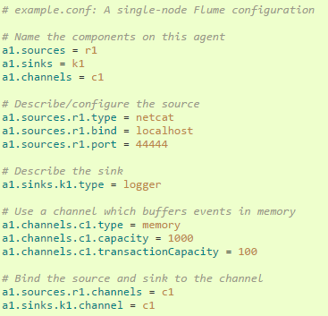
A single-node Flume configuration
Source : http://flume.apache.org/FlumeUserGuide.html#data-flow-model

Slide 48
Starting a flume agent
An agent is started using a shell script called flume-ng which is located in the bin directory of the Flume distribution.
You need to specify the agent name, the config directory, and the config file on the command line:
$ bin/flume-ng agent -n $agent_name -c conf -f conf/flume-conf.properties.template

Slide 49
Walk through Flume User Guide
https://flume.apache.org/FlumeUserGuide.html

Slide 50
Quiz
1. Flume can be used to import data from RDBMS to HDFS?
True
False
2. A flume agent consists of:
Source
Channel
Sink
All of the Above

Slide 51
Quiz-Answers
1. Flume can be used to import data from RDBMS to HDFS?
True
False
2. A flume agent consists of:
Source
Channel
Sink
All of the Above
B: False
D: All of the above

Slide 52
Oozie

Slide 53
Motivation for Oozie
Many Problems can not be solved using single Map Reduce jobs
Workflow of jobs must be created
Sample workflow:
Rune Job A
Take Output of Job A as a Input to Job B
Take output of Job B as a input to Job C
It is easy if the workflow is linear
Driver code can be created
Source
Job A
Job B
Job C
Final Output

Slide 54
Motivation for Oozie
If the workflow is more complex then Driver code becomes much more difficult to maintain
Eg: Running multiple jobs in parallel, using the output from all of those jobs as the input to the next job
Eg: set of sqoop jobs , set of HDFC commands (ingecting data manually), running set of MR jobs to process, running set of Pig and Hive jobs

Slide 55
Oozie Overview
Oozie is a workflow scheduler system to manage Apache Hadoop jobs.
Oozie Workflow jobs triggered by time (frequency) and data availability.
Oozie is integrated with the rest of the Hadoop stack
Hadoop specific jobs - Java map-reduce, Streaming map-reduce, Pig, Hive, and Sqoop etc)
System specific jobs -Java programs and shell scripts.
Oozie is a scalable, reliable and extensible system.
Main two capabilities are
Workflow – Collections of Actions
Coordinators - For recurring actions

Slide 56
Defining an oozie workflow
start
Action
Process
Control flow
Action
Action
Process
Process
Action
End
Action
Process
Process

Slide 57
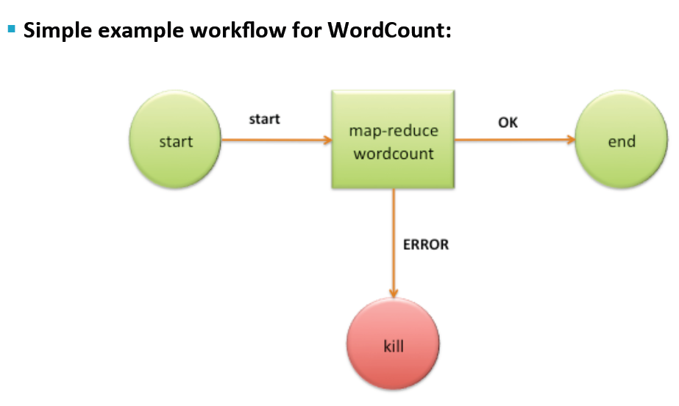
Sample Workflow
Sample Workflow for word count problem

Slide 58
Submitting a Workflow Job – Sample Code
Oozue.wf.application.path=hdfs://node:8020/path/to/app
#Hadoop Resource Manager
resourceManager=node:8050
#Hadoop fs.default.name
nameNode=hdfs://node:8020
#Hadoop mapred.queue.name
queueName=default
#Application-specific properties
taxCode=2012

Slide 59
Making Decsion using Oozie – Sample Code
<start to="action1"/>
<action name="action1">
<capture-output/>
<ok to="decision1"/>
<error to="fail"/>
</action>
<decision name="decision1">
<switch>
<case to ="action2">
${{wf:actionData('Data('action1')[key1]=="value")}
</case>
<case to="action3">
${{wf:actionData('Data('action1')[key1]=="value")}
</case>
<default to=fail"/>
</switch>
</decision>

Slide 60
Show Sample Oozie Code

Slide 61
Q & A

